Slide 1
How to Add and Subtract Large Numbers
Yes, this is serious.
Prerequisite: Be able to add and subtract any two numbers between 0 and 18. If you need to use your fingers a lot, that is OK. Just pause the video when you need to.

Slide 4
The Problem
7968 - 5899 ????

Slide 5
Adding
9 + 2 11

Slide 6
Adding
19 + 2 21

Slide 7
Adding
10 + 9 + 2 10 + 11

Slide 8
Adding
10
10 + 9
+ 2
- 10
20 + 1

Slide 9
Adding
19 + 2

Slide 10
Adding
19 + 2 1

Slide 11
Adding
1
19 + 2 1

Slide 12
Adding
1
19 + 2 21

Slide 13
Adding
1
19 + 2 21
Done!

Slide 14
Adding
9940 + 8374

Slide 15
Adding
9940 + 8374 4

Slide 16
Adding
9940 + 8374 14

Slide 17
Adding
1
9940 + 8374 14

Slide 18
Adding
1
9940 + 8374 314

Slide 19
Adding
1 1
9940 + 8374 314

Slide 20
Adding
1 1
9940 + 8374 18314

Slide 21
Adding
1 1
9940 + 8374 18314
Done!

Slide 22
Subtracting
In adding, we piled on tens, hundreds, thousands, etc.. from the right to the left.
In subtraction, we’re going to be stealing tens, hundreds, thousands, etc.. from the left to the right.

Slide 23
Subtracting
In adding, we piled on tens, hundreds, thousands, etc.. from the right to the left.
In subtraction, we’re going to be stealing tens, hundreds, thousands, etc.. from the left to the right.
Some politically correct instructors call this stealing borrowing.

Slide 24
Subtracting
3344 - 1097

Slide 25
Subtracting
3344 - 1097 -3

Slide 26
Subtracting
3344 - 1097
?
=

Slide 27
Subtracting
3344 - 1097
?
=
(4-7) + 10(4-9) + 100(3-0) + 1000(3-1)

Slide 28
Subtracting
3344 - 1097
?
=
(4-7) + 10(4-9) + 100(3-0) + 1000(3-1)
-3 + 40 - 90 + 300 + 3000 - 1000

Slide 29
Subtracting
3344 - 1097
?
=
(4-7) + 10(4-9) + 100(3-0) + 1000(3-1)
-3 + 40 - 90 + 300 + 3000 - 1000
340 + 2000 - 93

Slide 30
Subtracting
3344 - 1097
?
=
(4-7) + 10(4-9) + 100(3-0) + 1000(3-1)
-3 + 40 - 90 + 300 + 3000 - 1000
340 + 2000 - 93
2340 - 93

Slide 31
Subtracting
3344 - 1097
?
=
(4-7) + 10(4-9) + 100(3-0) + 1000(3-1)
-3 + 40 - 90 + 300 + 3000 - 1000
340 + 2000 - 93
2340 - 93
2340 - 93

Slide 32
Subtracting
3344 - 1097
?
=
(4-7) + 10(4-9) + 100(3-0) + 1000(3-1)
-3 + 40 - 90 + 300 + 3000 - 1000
340 + 2000 - 93
2340 - 93
2340 - 93 -3

Slide 33
Subtracting
2340 - 93

Slide 34
Subtracting
40 - 3 37

Slide 35
Subtracting
30 + 10 - 3 30 + 7

Slide 36
Subtracting
2340 - 93

Slide 37
Subtracting
3
2340 - 93

Slide 38
Subtracting
3
2340 - 93

Slide 39
Subtracting
3
2340 - 93 7

Slide 40
Subtracting
2 3
2340 - 93 7

Slide 41
Subtracting
2 13
2340 - 93 7

Slide 42
Subtracting
2 13
2340 - 93 47

Slide 43
Subtracting
2 13
2340 - 93 2247

Slide 44
Subtracting
2 13
2340 - 93 2247
Done!

Slide 45
Subtracting
3344 - 1097 2247

Slide 46
Subtracting
7968 - 5899

Slide 47
Subtracting
5
7968 - 5899

Slide 48
Subtracting
5
7968 - 5899 9

Slide 49
Subtracting
8 15
7968 - 5899 9

Slide 50
Subtracting
8 15
7968 - 5899 69

Slide 51
Subtracting
8 15
7968 - 5899 2069
Done!

Slide 52
Subtracting
2100 - 1063

Slide 53
Subtracting
2100 - 1063

Slide 54
Subtracting
0
2100 - 1063

Slide 55
Subtracting
0 9
2100 - 1063

Slide 56
Subtracting
0 9
2100 - 1063

Slide 57
Subtracting
0 9
2100 - 1063 7

Slide 58
Subtracting
0 9
2100 - 1063 37

Slide 59
Subtracting
0 9
2100 - 1063 1037
Done!

Slide 60
Khan Academy
Non-profit organization
Goal: Provide a high quality education to anyone, anywhere, for free
Our education is a bit like Swiss cheese – tasty but there are a lot of holes.
Exercises and tutorials are self-directed, fun
Game mechanics: badges are awarded
Videos for when you get stuck

Slide 61
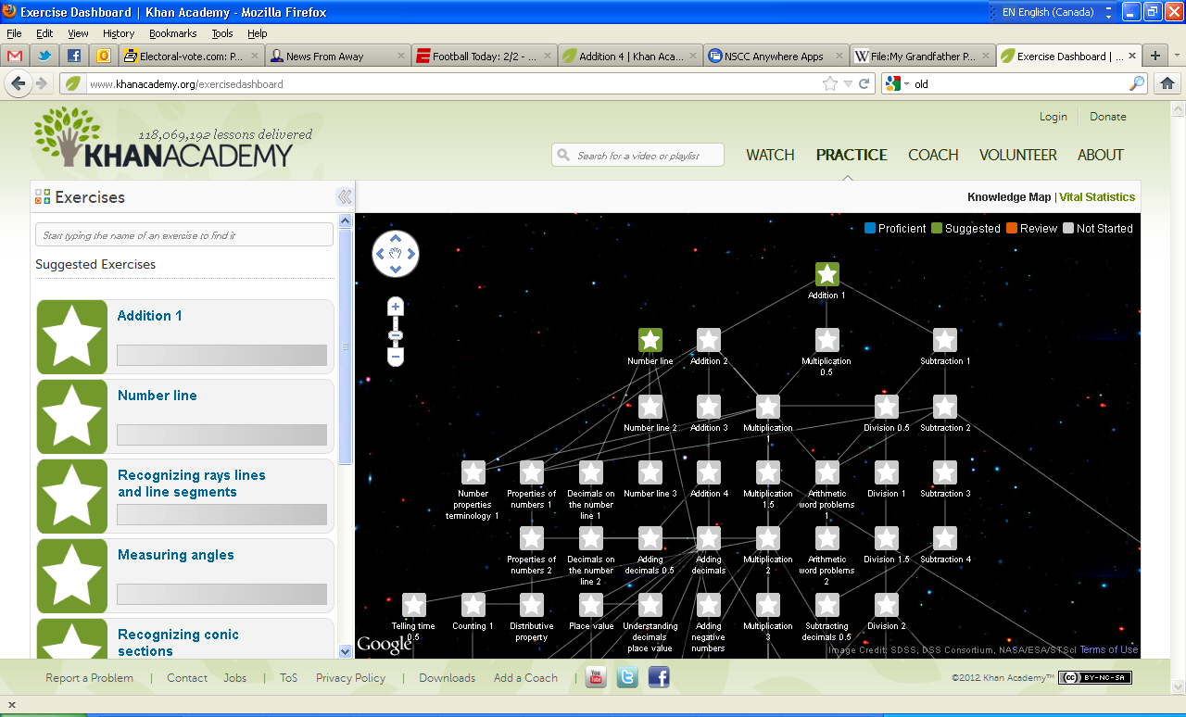

Slide 62
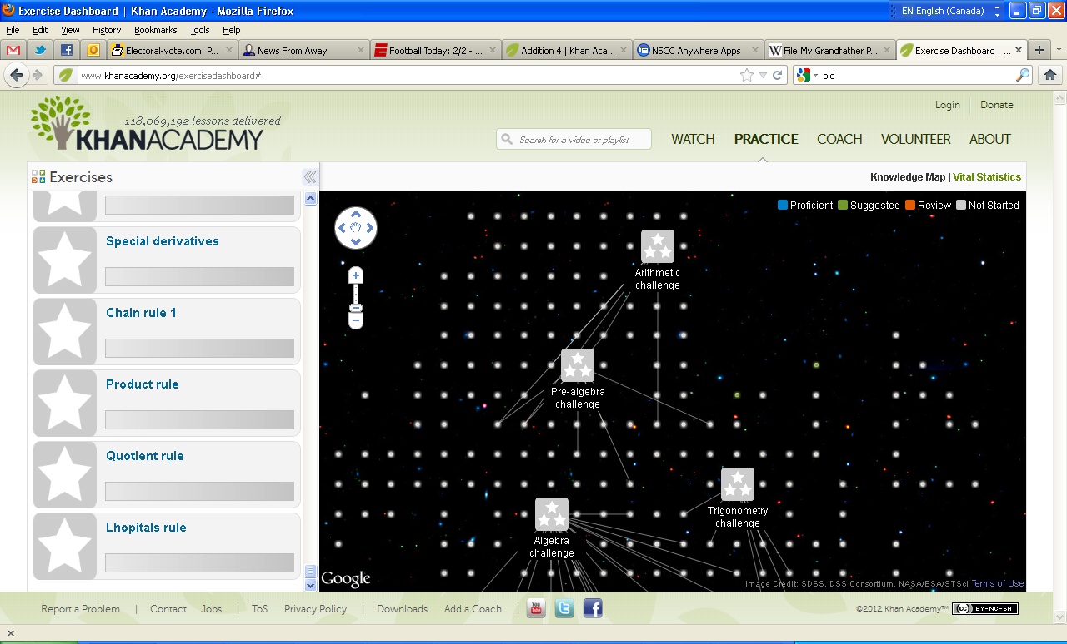

Slide 63
Khan Academy
See Salman Khan’s TED talk, “Let’s use video to reinvent education”: http://www.youtube.com/watch?v=nTFEUsudhfs or enter “tinyurl.com/khan-tedtalk”
And… start sharpening those skills! http://www.khanacademy.org

Slide 64
